Slide 1

Chapter 22 Java Collections Framework

Slide 2
Objectives
To describe the Java Collections Framework hierarchy (§§22.1-22.2).
To use the common methods defined in the Collection interface for operating sets and lists (§22.3).
To use the Iterator interface to traverse a collection (§22.4).
To use the for-each loop to simplify traversing a collection (§22.4).
To explore how and when to use HashSet (§22.4.1), LinkedHashSet (§22.4.2), or TreeSet (§22.4.3) to store elements.
To compare elements using the Comparable interface and the Comparator interface (§22.5).
To explore how and when to use ArrayList or LinkedList to store elements (§22.6).
To use the static utility methods in the Collections class for sorting, searching, shuffling lists, and finding the largest and smallest element in collections (§22.7).
To compare performance of sets and lists (§22.8).
To distinguish between Vector and ArrayList, and to use the Stack class for creating stacks (§22.9).
To explore the relationships among Collection, Queue, LinkedList, and PriorityQueue and to create priority queues using the PriorityQueue class (§22.10).
To tell the differences between Collection and Map, and describe when and how to use HashMap, LinkedHashMap, and TreeMap to store values associated with keys (§22.11).
To obtain singleton sets, lists, and maps, and unmodifiable sets, lists, and maps, using the static methods in the Collections class (§22.12).

Slide 3
Java Collection Framework hierarchy
A collection is a container object that represents a group of objects, often referred to as elements. The Java Collections Framework supports three types of collections, named sets, lists, and maps.

Slide 4
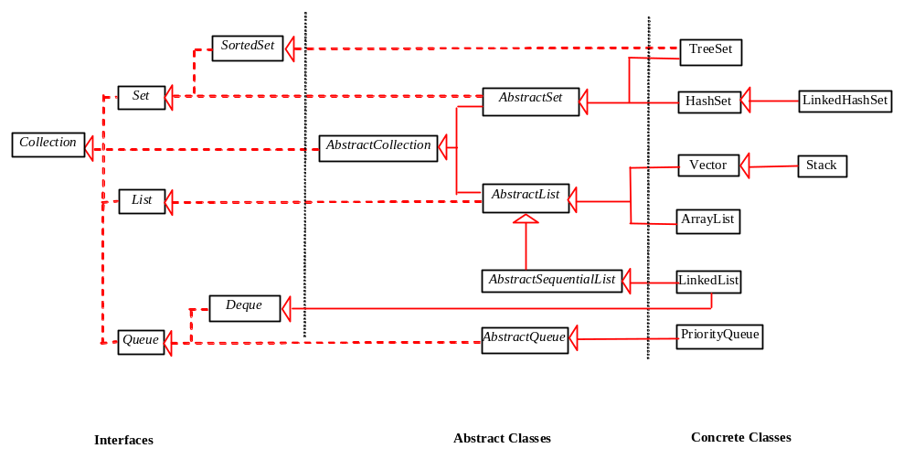
Java Collection Framework hierarchy, cont.
Set and List are subinterfaces of Collection.

Slide 5
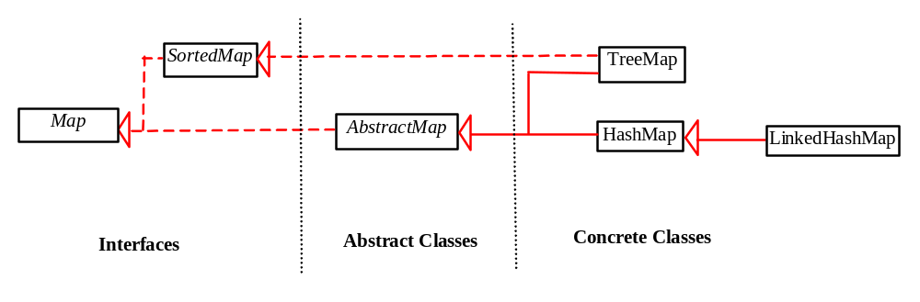
Java Collection Framework hierarchy, cont.
An instance of Map represents a group of objects, each of which is associated with a key. You can get the object from a map using a key, and you have to use a key to put the object into the map.

Slide 6
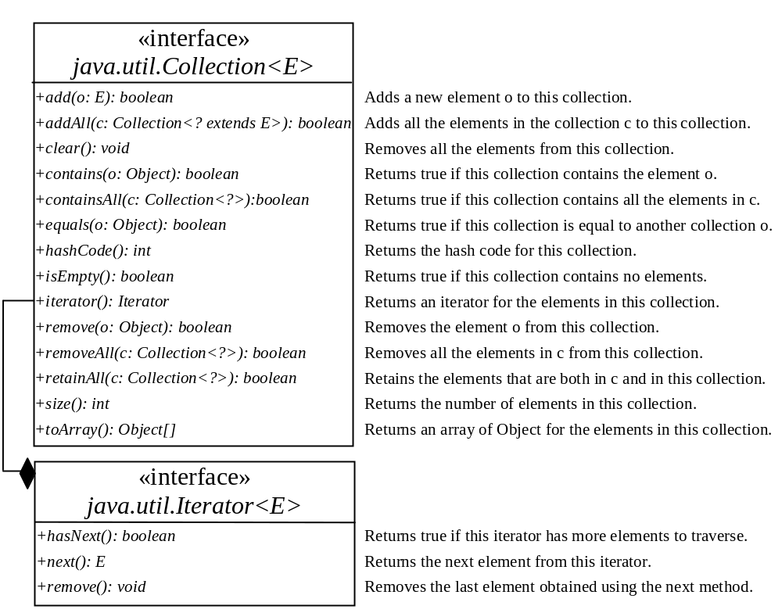
The Collection Interface
The Collection interface is the root interface for manipulating a collection of objects.

Slide 7
The Set Interface
The Set interface extends the Collection interface. It does not introduce new methods or constants, but it stipulates that an instance of Set contains no duplicate elements. The concrete classes that implement Set must ensure that no duplicate elements can be added to the set. That is no two elements e1 and e2 can be in the set such that e1.equals(e2) is true.

Slide 8
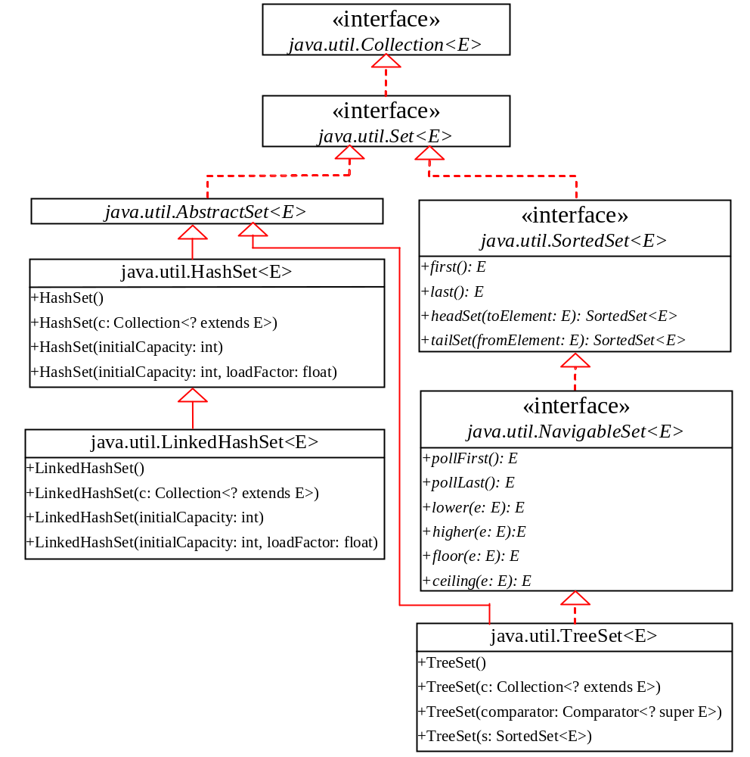
The Set Interface Hierarchy

Slide 9
The AbstractSet Class
The AbstractSet class is a convenience class that extends AbstractCollection and implements Set. The AbstractSet class provides concrete implementations for the equals method and the hashCode method. The hash code of a set is the sum of the hash code of all the elements in the set. Since the size method and iterator method are not implemented in the AbstractSet class, AbstractSet is an abstract class.

Slide 10
The HashSet Class
The HashSet class is a concrete class that implements Set. It can be used to store duplicate-free elements. For efficiency, objects added to a hash set need to implement the hashCode method in a manner that properly disperses the hash code.

Slide 11
Example: Using HashSet and Iterator
This example creates a hash set filled with strings, and uses an iterator to traverse the elements in the list.
TestHashSet
Run

Slide 12
TIP: for-each loop
You can simplify the code in Lines 21-26 using a JDK 1.5 enhanced for loop without using an iterator, as follows:
for (Object element: set)
System.out.print(element.toString() + " ");

Slide 13
Example: Using LinkedHashSet
This example creates a hash set filled with strings, and uses an iterator to traverse the elements in the list.
TestLinkedHashSet
Run

Slide 14
The SortedSet Interface and the TreeSet Class
SortedSet is a subinterface of Set, which guarantees that the elements in the set are sorted. TreeSet is a concrete class that implements the SortedSet interface. You can use an iterator to traverse the elements in the sorted order. The elements can be sorted in two ways.

Slide 15
The SortedSet Interface and the TreeSet Class, cont.
One way is to use the Comparable interface.
The other way is to specify a comparator for the elements in the set if the class for the elements does not implement the Comparable interface, or you don’t want to use the compareTo method in the class that implements the Comparable interface. This approach is referred to as order by comparator.

Slide 16
Example: Using TreeSet to Sort Elements in a Set
This example creates a hash set filled with strings, and then creates a tree set for the same strings. The strings are sorted in the tree set using the compareTo method in the Comparable interface. The example also creates a tree set of geometric objects. The geometric objects are sorted using the compare method in the Comparator interface.
TestTreeSet
Run

Slide 17
The Comparator Interface
Sometimes you want to insert elements of different types into a tree set. The elements may not be instances of Comparable or are not comparable. You can define a comparator to compare these elements. To do so, create a class that implements the java.util.Comparator interface. The Comparator interface has two methods, compare and equals.

Slide 18
The Comparator Interface
public int compare(Object element1, Object element2)
Returns a negative value if element1 is less than element2, a positive value if element1 is greater than element2, and zero if they are equal.
public boolean equals(Object element)
Returns true if the specified object is also a comparator and imposes the same ordering as this comparator.
GeometricObjectComparator

Slide 19
Example: The Using Comparator to Sort Elements in a Set
Write a program that demonstrates how to sort elements in a tree set using the Comparator interface. The example creates a tree set of geometric objects. The geometric objects are sorted using the compare method in the Comparator interface.
TestTreeSetWithComparator
Run

Slide 20
The List Interface
A set stores non-duplicate elements. To allow duplicate elements to be stored in a collection, you need to use a list. A list can not only store duplicate elements, but can also allow the user to specify where the element is stored. The user can access the element by index.

Slide 21
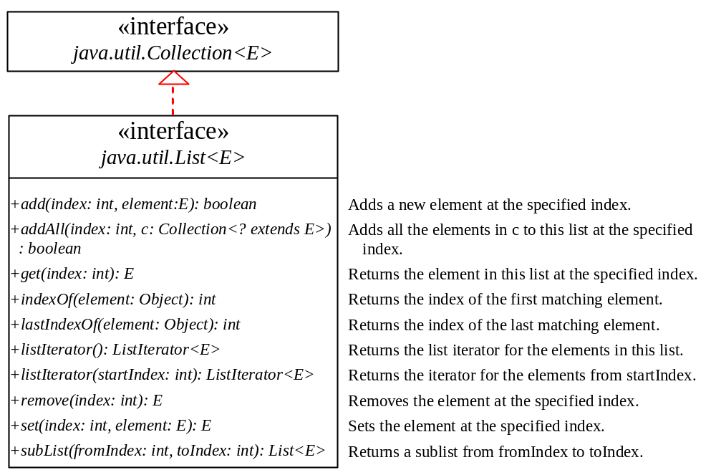
The List Interface, cont.

Slide 22
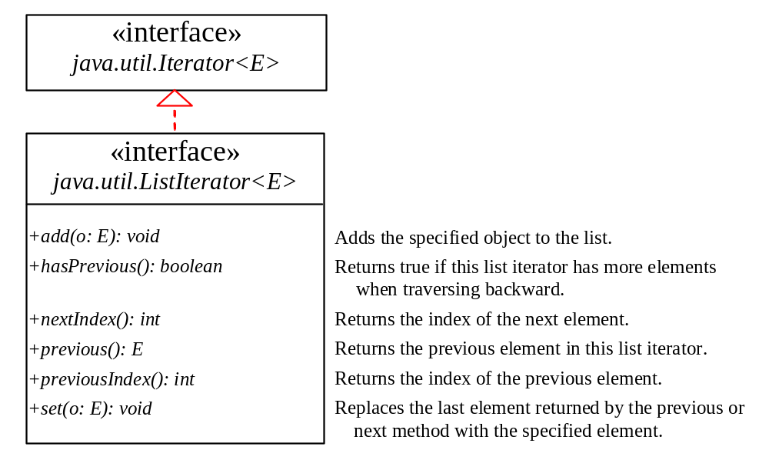
The List Iterator

Slide 23
ArrayList and LinkedList
The ArrayList class and the LinkedList class are concrete implementations of the List interface. Which of the two classes you use depends on your specific needs. If you need to support random access through an index without inserting or removing elements from any place other than the end, ArrayList offers the most efficient collection. If, however, your application requires the insertion or deletion of elements from any place in the list, you should choose LinkedList. A list can grow or shrink dynamically. An array is fixed once it is created. If your application does not require insertion or deletion of elements, the most efficient data structure is the array.

Slide 24
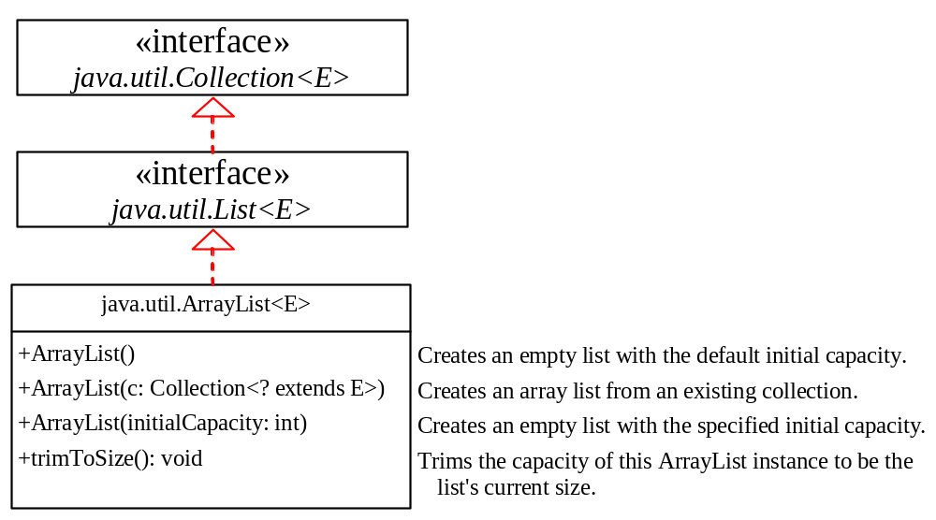
java.util.ArrayList

Slide 25
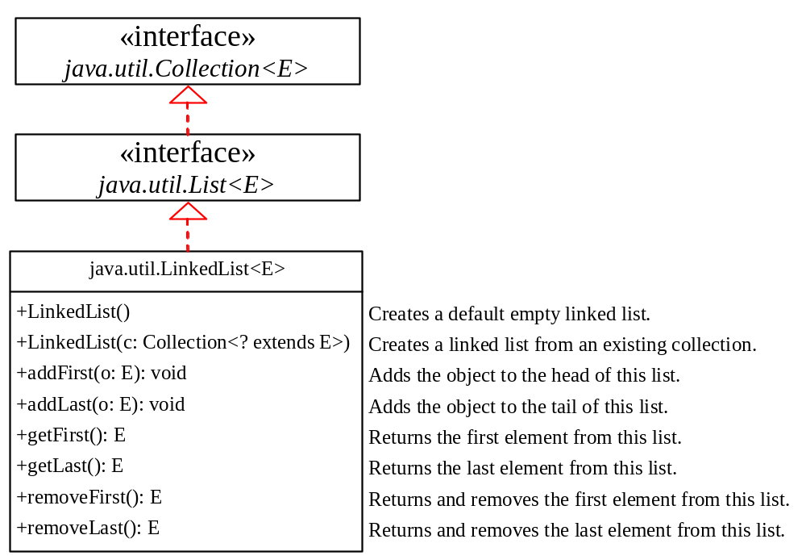
java.util.LinkedList

Slide 26
Example: Using ArrayList and LinkedList
This example creates an array list filled with numbers, and inserts new elements into the specified location in the list. The example also creates a linked list from the array list, inserts and removes the elements from the list. Finally, the example traverses the list forward and backward.
TestList
Run

Slide 27
The Collections Class
The Collections class contains various static methods for operating on collections and maps, for creating synchronized collection classes, and for creating read-only collection classes.

Slide 28
Performance of Sets and Lists
SetListPerformanceTest
Run

Slide 29
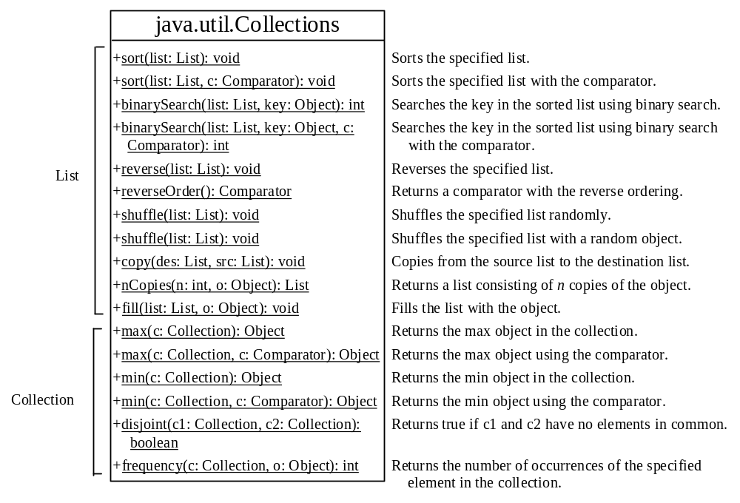
The Collections Class UML Diagram

Slide 30
Example: Using the Collections Class
This example demonstrates using the methods in the Collections class. The example creates a list, sorts it, and searches for an element. The example wraps the list into a synchronized and read-only list.
TestCollections
Run

Slide 31
The Vector and Stack Classes
The Java Collections Framework was introduced with Java 2. Several data structures were supported prior to Java 2. Among them are the Vector class and the Stack class. These classes were redesigned to fit into the Java Collections Framework, but their old-style methods are retained for compatibility. This section introduces the Vector class and the Stack class.

Slide 32
The Vector Class
In Java 2, Vector is the same as ArrayList, except that Vector contains the synchronized methods for accessing and modifying the vector. None of the new collection data structures introduced so far are synchronized. If synchronization is required, you can use the synchronized versions of the collection classes. These classes are introduced later in the section, “The Collections Class.”

Slide 33
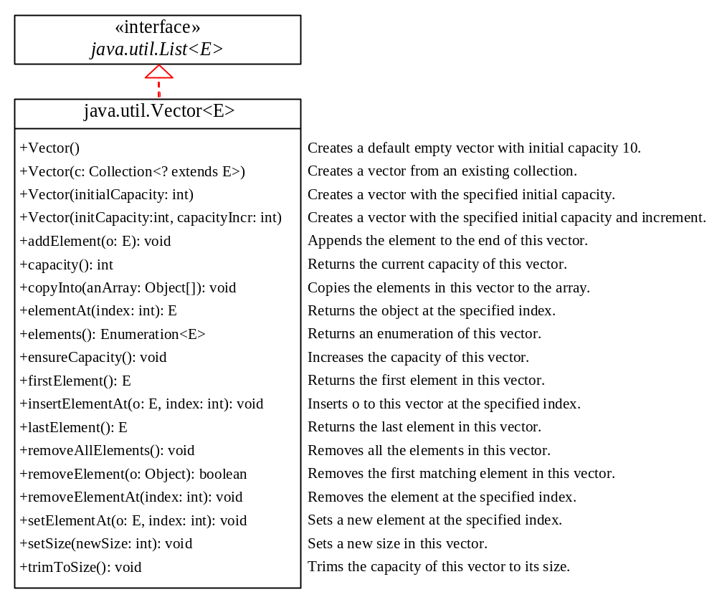
The Vector Class, cont.

Slide 34
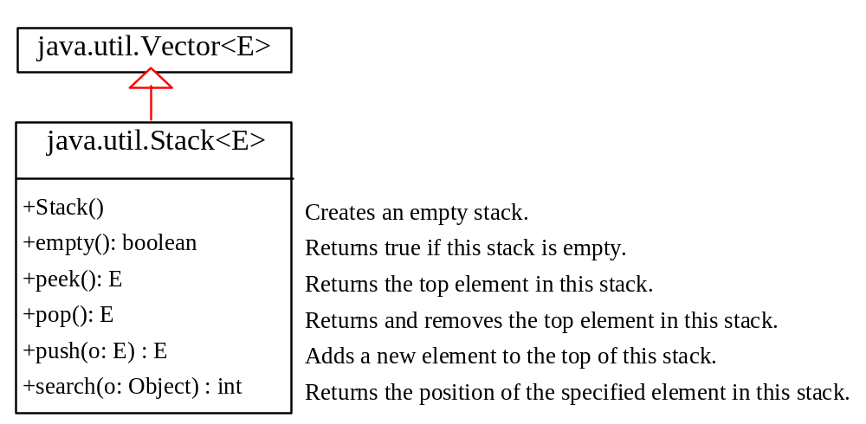
The Stack Class
The Stack class represents a last-in-first-out stack of objects. The elements are accessed only from the top of the stack. You can retrieve, insert, or remove an element from the top of the stack.

Slide 35
Queues and Priority Queues
A queue is a first-in/first-out data structure. Elements are appended to the end of the queue and are removed from the beginning of the queue. In a priority queue, elements are assigned priorities. When accessing elements, the element with the highest priority is removed first.

Slide 36
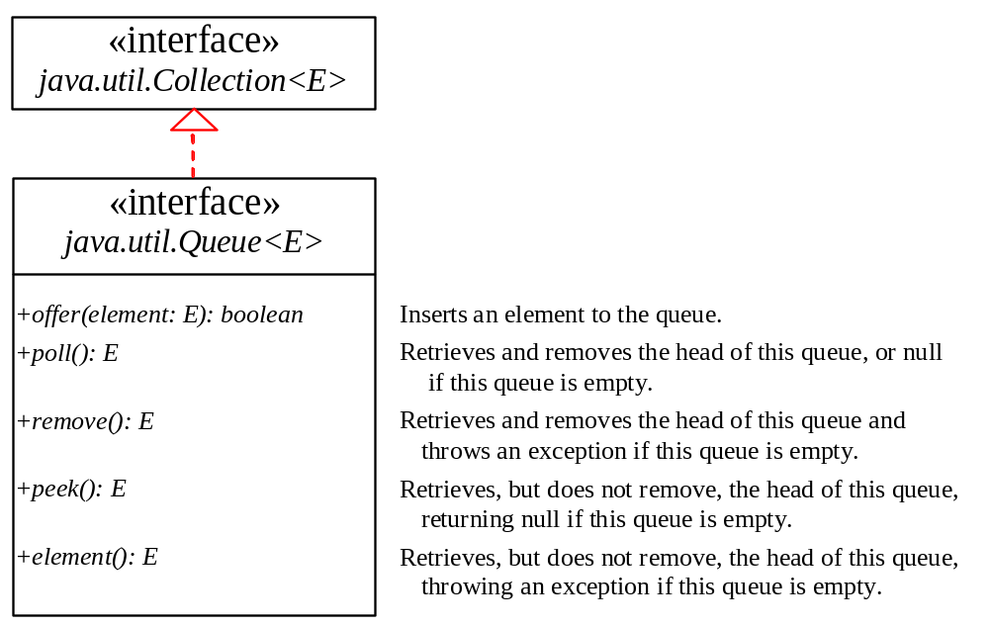
The Queue Interface

Slide 37
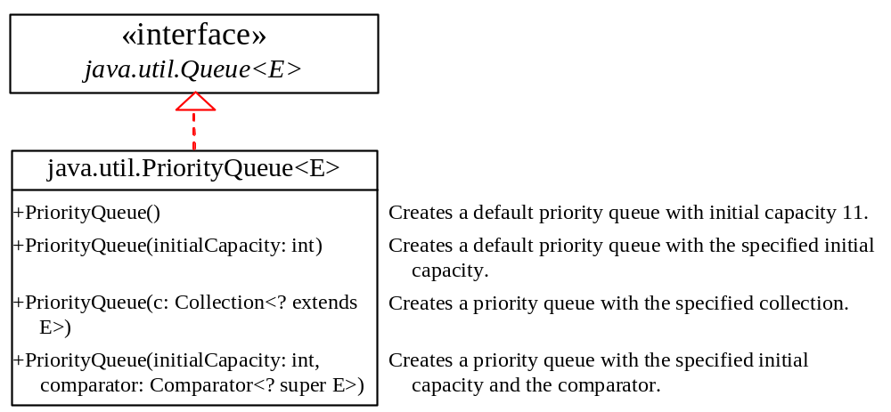
The PriorityQueue Class
PriorityQueueDemo
Run

Slide 38
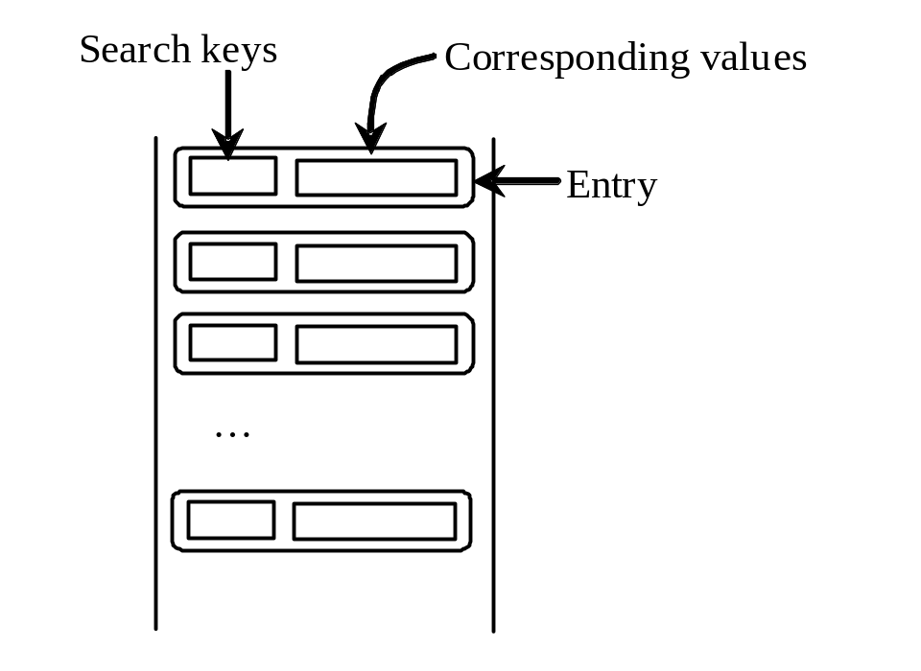
The Map Interface
The Map interface maps keys to the elements. The keys are like indexes. In List, the indexes are integer. In Map, the keys can be any objects.

Slide 39
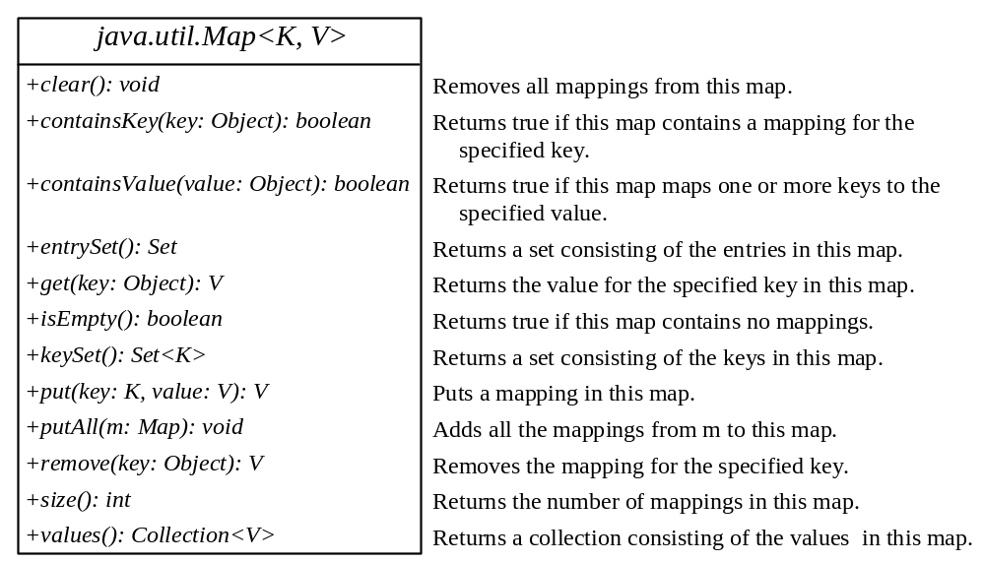
The Map Interface UML Diagram

Slide 40
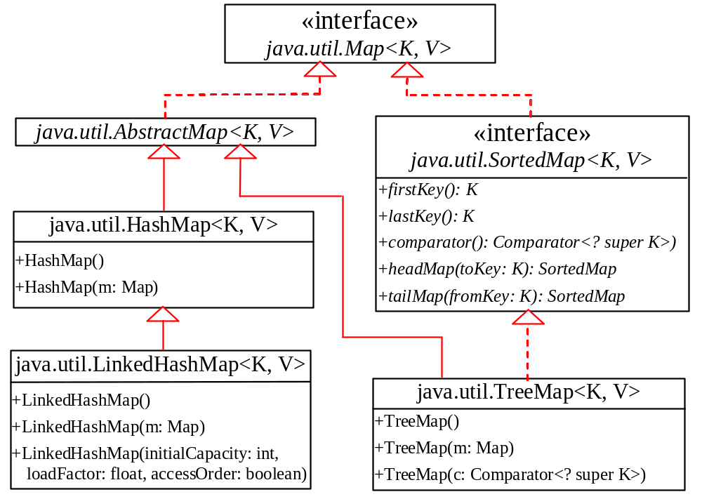
Concrete Map Classes

Slide 41
HashMap and TreeMap
The HashMap and TreeMap classes are two concrete implementations of the Map interface. The HashMap class is efficient for locating a value, inserting a mapping, and deleting a mapping. The TreeMap class, implementing SortedMap, is efficient for traversing the keys in a sorted order.

Slide 42
LinkedHashMap
LinkedHashMap was introduced in JDK 1.4. It extends HashMap with a linked list implementation that supports an ordering of the entries in the map. The entries in a HashMap are not ordered, but the entries in a LinkedHashMap can be retrieved in the order in which they were inserted into the map (known as the insertion order), or the order in which they were last accessed, from least recently accessed to most recently (access order). The no-arg constructor constructs a LinkedHashMap with the insertion order. To construct a LinkedHashMap with the access order, use the LinkedHashMap(initialCapacity, loadFactor, true).

Slide 43
Example: Using HashMap and TreeMap
This example creates a hash map that maps borrowers to mortgages. The program first creates a hash map with the borrower’s name as its key and mortgage as its value. The program then creates a tree map from the hash map, and displays the mappings in ascending order of the keys.
TestMap
Run

Slide 44
Example: Counting the Occurrences of Words in a Text
This program counts the occurrences of words in a text and displays the words and their occurrences in ascending order of the words. The program uses a hash map to store a pair consisting of a word and its count. For each word, check whether it is already a key in the map. If not, add the key and value 1 to the map. Otherwise, increase the value for the word (key) by 1 in the map. To sort the map, convert it to a tree map.
CountOccurrenceOfWords
Run

Slide 45
The Arrays Class
The Arrays class contains various static methods for sorting and searching arrays, for comparing arrays, and for filling array elements. It also contains a method for converting an array to a list.

Slide 46
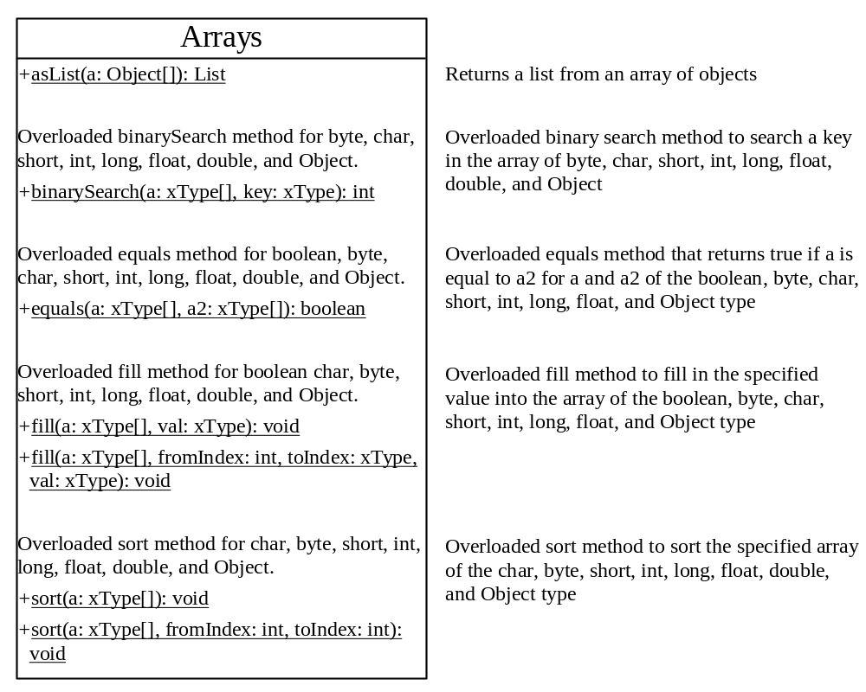
The Arrays Class UML Diagram

Slide 47
Example: Using the Arrays Class
This example demonstrates using the methods in the Arrays class. The example creates an array of int values, fills part of the array with 50, sorts it, searches for an element, and compares the array with another array.
TestArrays
Run

